Slide 1
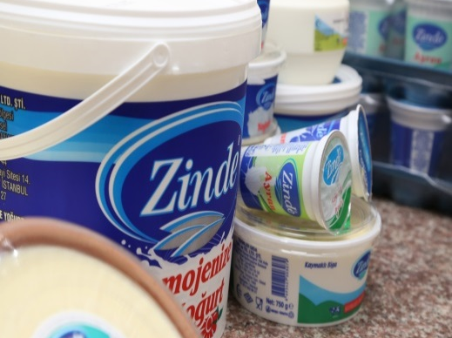
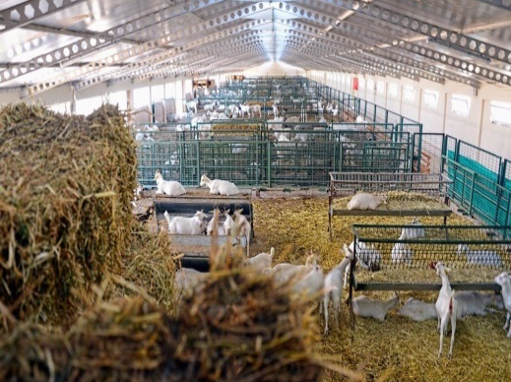
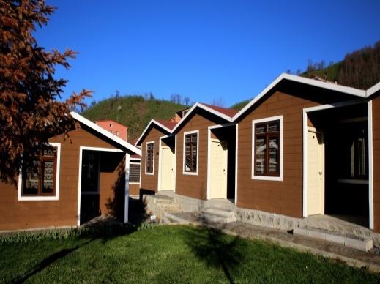
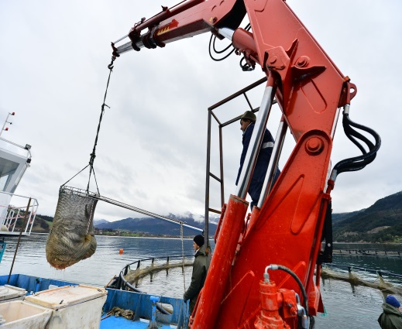
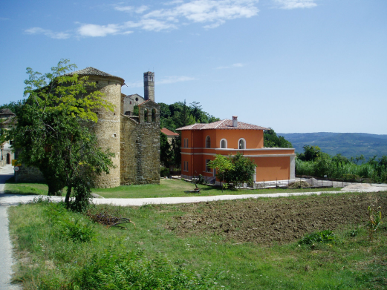
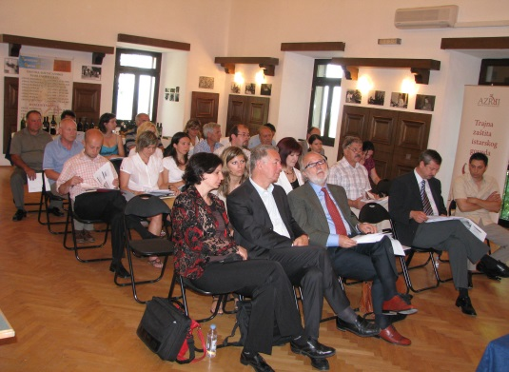
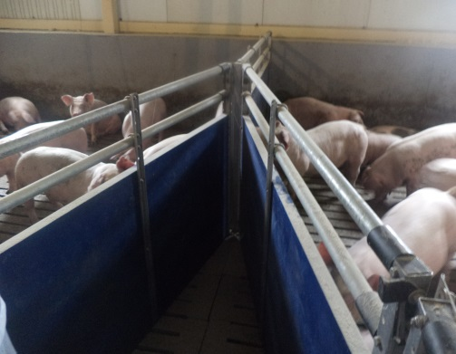
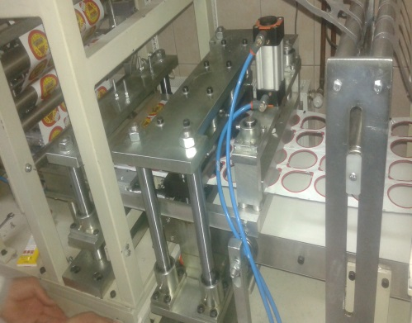
Progress with preparation for IPARD III

Slide 2

What is IPARD?
IPARD = EU Pre-accession Assistance for Rural Development
Part of Instrument for Pre-accession Assistance (IPA), managed by NEAR
Aims at making their agricultural sector and rural areas more sustainable, aligning them with the EU's common agricultural policy
Total budget (IPARD II) ~EUR 1.1 billion (~10% of IPA), managed by AGRI via indirect management
Funding allocated per country on the basis of adopted country specific IPARD Programmes for entrusted measures

Slide 3
Geographic scope of IPARD
IPARD I - Turkey, North Macedonia, Croatia
IPARD II & IPARD III - Turkey, North Macedonia, Albania, Montenegro, Serbia
Potential IPARD beneficiaries – Kosovo*, Bosnia & Herzegovina

Slide 4
Implementing IPARD: a balancing act
Ensuring the EU tax-payers' money is well spent
Designated funds reaching beneficiaries
Increasing compliance with EU standards
Building-up institutional capacities in the countries

Slide 5
Challenges to agriculture in the region
Small and fragmented farms
Low efficiency in farming
Basic processing capacity
Low level of technical knowledge and technological development
Lack of investments
Poor R&D capability
Out-migration from rural areas
Lack of cooperation and trust due to the past
Environment and climate - low political priority

Slide 7
IPA/IPARD III architecture
adoption
NDICI
Expected in June
Legal basis
Regulations
IPA III REGULATION
Expected in September
Overview of legal framework
IPA II
IMPLEMENTING REGULATION
Framework
Agreements
IPA III Programming Framework
Strategic Responses
Implementing acts
Planning & programming
IPARD Sectoral
Agreements
COUNTRY PROGRAMMES / ACTIONS
MULTI-COUNTRY PROGRAMMES
Financing
Agreements

Slide 8
IPARD III – in the process
IPA III Regulation – in the process of adoption
Budget – similar to IPARD II
Next:
  IPA Implementing Regulation,
  Programming Framework,
  Framework and Sectoral Agreements
  Financing Agreement

Slide 9
IPARD III - done
Drafted Guidance documents, revised and agreed measure fiches
Link to Green Agenda for the WB, e.g.,
  Manure and waste management, organic farming, modernisation of assets and farming methods, sustainable use of natural resources
Two new measures proposed:
  Financial instruments and
  Innovation and knowledge transfer

Slide 10
IPARD III – List of measures (I)
M1-Investments in physical assets of agricultural holdings (5+0)
M2-Support for the setting up of producer groups (0)
M3-Investments in physical assets concerning processing and marketing of agricultural and fishery products (5+0)
M4-Agri-environment-climate and organic farming measure (1+4)
M5-Implementation of local development strategies - LEADER approach (1+4)
M6-Investments in rural public infrastructure (0+5)

Slide 11
IPARD III – List of measures (II)
M7-Farm diversification and business development (5+0)
M8-Improvement of skills and competences (0)
M9-Technical assistance (4+1)
M10-Advisory services (0+3)
M11-Establishment and protection of forests (0+3)
M12-Financial instruments (0)
M13-Promotion of cooperation for innovation and knowledge transfer (0)

Slide 12
What is next?
Drafting and public consultation on IPARD III Programmes, Ex-ante assessment
Submission of draft IPARD III Programmes to the European Commission – second half of Septemeber 2021
Adoption of IPARD III Programmes – December 2021
Start of IPARD III implementation - 2022

Slide 13
Thank you!
Zigo Rutkovskis
Programme Manager
DG AGRI, IPARD Unit (E.5)
Zigo.Rutkovskis@ec.europa.eu

