Slide 1
MREŽA ZA RURALNI RAZVOJ U BOSNI I HERCEGOVINI (MRR u BiH) RURAL DEVELOPMENT NETWORK IN BOSNIA AND HERZEGOVINA (RDN in BiH)
2nd Balkan Rural Parliament
“Reviving of rural Western Balkans - moving towards EU integration”
15th June - 16th June 2021
Ohrid, North Macedonia

Slide 2
HISTORY
Rural Development Network in Bosnia and Herzegovina (RDN in BiH) was established in Sarajevo, 2014.
RDN BiH have 14 member organizations. Membership structure consists of 13 civil society organisations and 1 Local action group (LAGs). RDN BiH operates on the overall territory of Bosnia and Herzegovina.
RDN BiH is established with a goal to achieve a strong and strategic partnership of civil society sector which operates in the field of rural development in BiH.
Rural Development Network in BiH intends to become a serious partner to public sector and contribute to the creation and shaping of public policies.

Slide 3
OBJECTIVES
To improve cooperation, dialogue and overall activity of civil society organisations and public bodies that operate in rural development sector, with the aim of representing the interests of rural population and enable exchange of information, knowledge, experiences and views of various stakeholders from rural areas.
To contribute to the improvement of quality of life in rural areas of Bosnia and Herzegovina by promoting sustainable usage of existing resources to stimulate development of rural areas and improve rural economy.
To represent the interests of RDN in BiH members

Slide 4
ACTIVITIES
- Support to the member organizations and other CSO and LAG’s active in rural development
Coordination with local institutions
Project implementation - project activities
Networking in BiH, Balkan region and EU

Slide 5
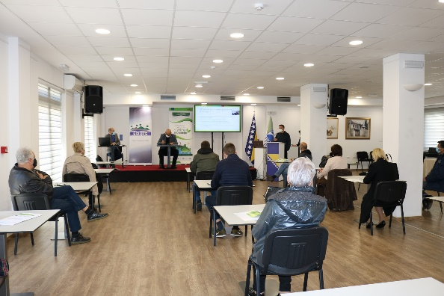
ACTIVITIES – NAGE PROJECT - BRDN
Sub-granting to 6 grassroot organizations, 6 projects financed and monitored
Public Debate on the Green Economy - The Situation in Stimulating the Green Economy in Agriculture and Rural Development in Bosnia and Herzegovina
Upcoming:
Education in green economy

Slide 6
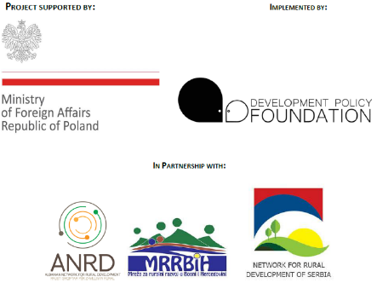
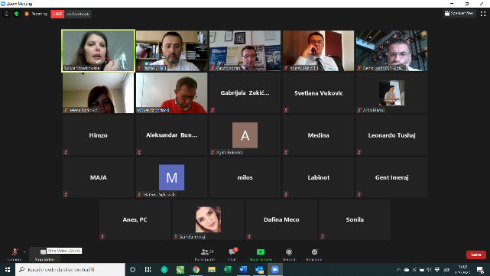
ACTIVITIES – NEW DIMENSIONS- Development Policy Foundation, Poland
The project includes a presentation, in-depth analysis and promotion among experts, opinion leaders and journalists of the best Polish experiences related to the transformation and modernization of villages and the benefits of EU membership in this area.
15 webinars for participants
15 online materials / podcasts, available in national languages, to show how to create a coherent and stable market for rural services, income diversification and increasing farm profitability - including short supply chains, food safety (also in the context of COVID), certification, obtaining EU geographical indications (GI), technological and IT innovation in agriculture, as well as practices favoring the creation of green jobs and livelihood biological and cultural diversity.

Slide 7
ACTIVITIES – GREEN WORKS PROJECT - CRP Tuzla and CERD Laktasi
Jan 1, 2021. – October 31, 2023
Overall objective: To enhance the impact of the civil society in the field of environmental protection and climate change by capacity building, networking and public campaign of local CSOs network
Promotion of clean air and soil solutions;
Improved capacity of at least 45 local CSOs for green solutions in soil and air protection, participation in decision making, advocacy and lobbying and monitoring of public policies, familiarised with the good EU practice and available mechanisms and actions of civil sector in this area;
Study on air pollution impact of residential households coal heating in Tuzla Canton area and agricultural production negative impact on soil pollution in Lijevče polje, wider Banja Luka region
Developed concept for introducing green financing mechanism with public sector institutions to reduce pollutions in air and soil;
“GreenWorks” promoted in BiH through the activities of the network, and increased public awareness on negative impact of fossil fuels and agricultural production to environmental pressures – air and soil pollution
Improved collaboration of “GreenWorks” CSOs with local cantonal, entities and national authorities in open and constructive institutional dialogue
Sub/granting to civil society organizations

