Slide 1
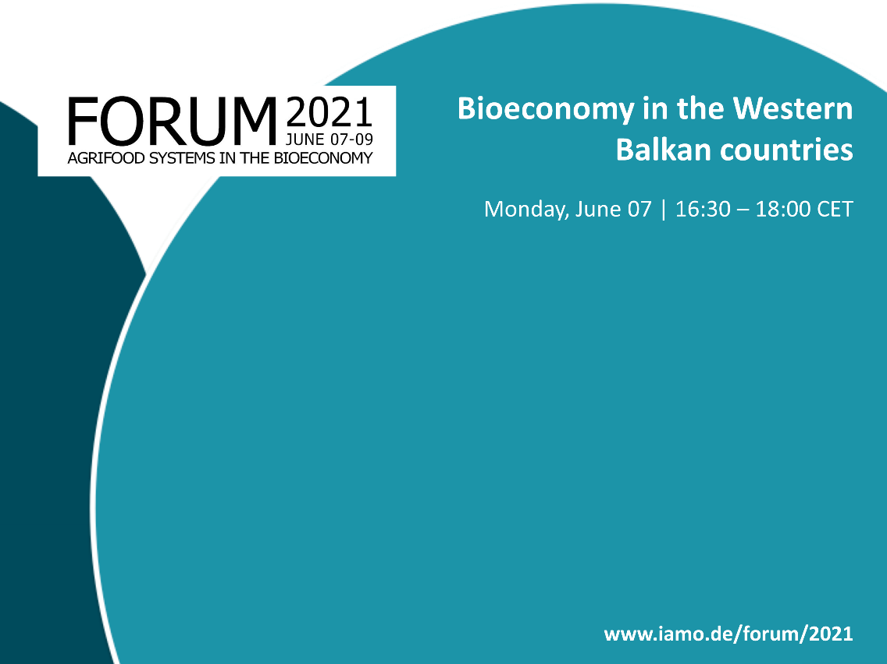
Challenges in the design of
policy framework for sustainable agriculture and rural development through green economy
in the Western Balkan countries
Aleksandra Martinovska Stojcheska
Ss. Cyril and Methodius University in Skopje
Faculty of Agricultural Sciences and Food - Skopje​

Slide 2
Outline
Objective, approach, sources
Agricultural and rural development policy framework design
Instruments and measures linked to sustainability and green economy
Concluding remarks

Slide 3
Objective AND APPROACH
The challenges ahead…
Agricultural and rural development policy design in the WB countries and its harmonisation with the EU CAP;
Focus on the policy framework for sustainable agriculture and rural development in light of the potential for green economy in the Western Balkan countries;
Comparative cross-country analysis - Albania (AL), Bosnia and Herzegovina (BA), North Macedonia (MK), Kosovo* (XK), Montenegro (ME), Serbia (RS);
The quantitative analysis covers the recent developments (2017 to 2019).

Slide 4
Background - sources
Martinovska Stojcheska, A.,
А. Kotevska, I. Janeska Stamenkovska, D. Dimitrievski, E. Zhllima, Ž. Vaško, S. Bajramović, M. Kerolli Mustafa, M. Spahić, V. Kovacević, A. A. Koç (authors), A. Martinovska Stojcheska, A. Kotevska, P. Ciaian, B. Ilic, D. Pavloska-Gjorgjieska, G. Salputra (editors) (2021) Recent agricultural policy developments in the context of the EU approximation process in the pre-accession countries, JRC Technical Report
Martinovska Stojcheska, A. (Ed.). (2020). State of affairs for fostering green economy in agriculture and rural development: Comparative analysis of programs and measures in the Western Balkan Countries and Croatia. Skopje: Rural Development Network of North Macedonia.

Slide 5
Sustainable development – green economy in the policy framework
Sustainable development declared as (one of) priorities in WBC strategic docs.
Included in the national strategies for agriculture and rural development - cornerstones of the respective policy in all countries.

Slide 6
key documents linked to agriculture - RD - sustainable development - green economy
Albania
Inter-sectoral Strategy for Agriculture and Rural Development (2014-20) Instrument for Pre-Accession Rural Development Programme (2014-20) Document of Forestry Policies (2019-30) Integrated Programme for Rural Development (2018-20) - 100 Villages Draft Sector Strategy for Irrigation and Drainage (2019-23) National Strategy for Development and Integration (2015-20) National Programme for European Integration (2017-21) The 2030 Agenda for Sustainable Development (2016-30) National Strategy on Climate Change and Action Plans (2018-30)
Bosnia and Herzegovina
Strategic Plan for Rural Development of Bosnia and Herzegovina - Framework Document (2018-21) Program of Rural Development of Federation of Bosnia and Herzegovina (2018-21) Strategy for Development of Agriculture and Rural Areas of Republika Srpska (2016-20) Mid-term Strategy of Agricultural Sector Development of Federation of Bosnia and Herzegovina Strategy of Agriculture and Rural Areas Development of Brcko District (2019-25) Strategy of Forestry Development of the Republika Srpska (2011-21) Strategy of Climate Change Adaptation and Low-emission Development for BiH Strategy of Nature Protection of the Republika Srpska Strategy of Environment Protection of Federation of Bosnia and Herzegovina (2008-18)
Kosovo
National Development Strategy (2016-21) Agriculture and Rural Development Programme (2014-20) Strategy for Climate Change (2019-28) Strategy for Local Economic Development (2019-23) Energy Strategy (2017-26) Sustainable Development in Kosovo (2018)
Montenegro
National Strategy for Sustainable Development (2016-30) Strategy for agriculture and rural development (2015-20) Instrument for Pre-Accession Rural Development Programme IPARD II (2014-20) National Strategy on climate change to 2030 The innovated Montenegrin Strategy for the transposition and implementation of the European Union environmental chapter 12 - Food Safety, Veterinary and Phytosanitary policies with a General Action Plan Forests and Forestry Strategy with Development Plan - National Forest Strategy (2019-23) National biodiversity strategy (2016-20)
North Macedonia
National Agriculture and Rural Development Strategy (2014-20) National Program for Agricultural Development and Rural Development (2018-22) Instrument for Pre-Accession Rural Development Programme IPARD II (2014-20) National Plan for Organic Production (2013-20) National Strategy for Sustainable Development (2009-30) Strategy for Environment and Climate Change (2014-20) National Strategy for Biological Diversity with action plan (2018-23) Industrial Strategy with Action Plan (2018-27) National Strategy for Small and Medium Enterprises (2018-23)
Serbia
Strategy of Agriculture and Rural Development of the Republic of Serbia (2014-24) National Program for Agriculture for the period (2018-20) National Program for Rural development for the period (2018-20) Instrument for Pre-Accession Rural Development Programme IPARD II (2014-20) National Strategy for Sustainable Use of Natural Resources and Goods (2012-22) Water Management Strategy on the Territory of the Republic of Serbia (2017-34) National Strategy for Sustainable Development (2007-17) National Programme for the Adoption of the Acquis (2018-21)

Slide 7
Sustainable development – green economy in the policy framework
Sustainable development declared as (one of) priorities in WBC strategic docs.
Included in the national strategies for agriculture and rural development - cornerstones of the respective policy in all countries.
Green economy as such is still lacking and is not being explicitly included in many of them, but references to the concept are contained in many of the strategic documents, related specifically to agriculture and rural development (recognized as vital area to the greening concept), and also as cross-cutting issue in other sectors.
What is missing in practice ?
  pursuing the defined strategical priorities and objectives,
  often unrealistic action plans,
  lack of coordination among sectors,
  appropriate tools/indicators to control and evaluate the implementation process.

Slide 8
Agricultural and rd policy Framework
EU accession - WB countries essential political goal
→ EU’s CAP represents the benchmark for agricultural policies in pre-accession countries to meet upon their accession: developing ability to take on the obligations of the EU membership, strong reliable management and control systems to align with the EU legal, administrative set-up, support system to facilitate integration of the agricultural sector into the EU single market and political decision-making process
Ag. policy strategic planning/policy cycle, administrative capacity, monitoring and evaluation, analytical support for policy formation and implementation – WB level
→ Overall assessment of the strategic policy framework: initial stage (AL, BA, XS, ME) and initial to medium stage (MK, RS).

Slide 9
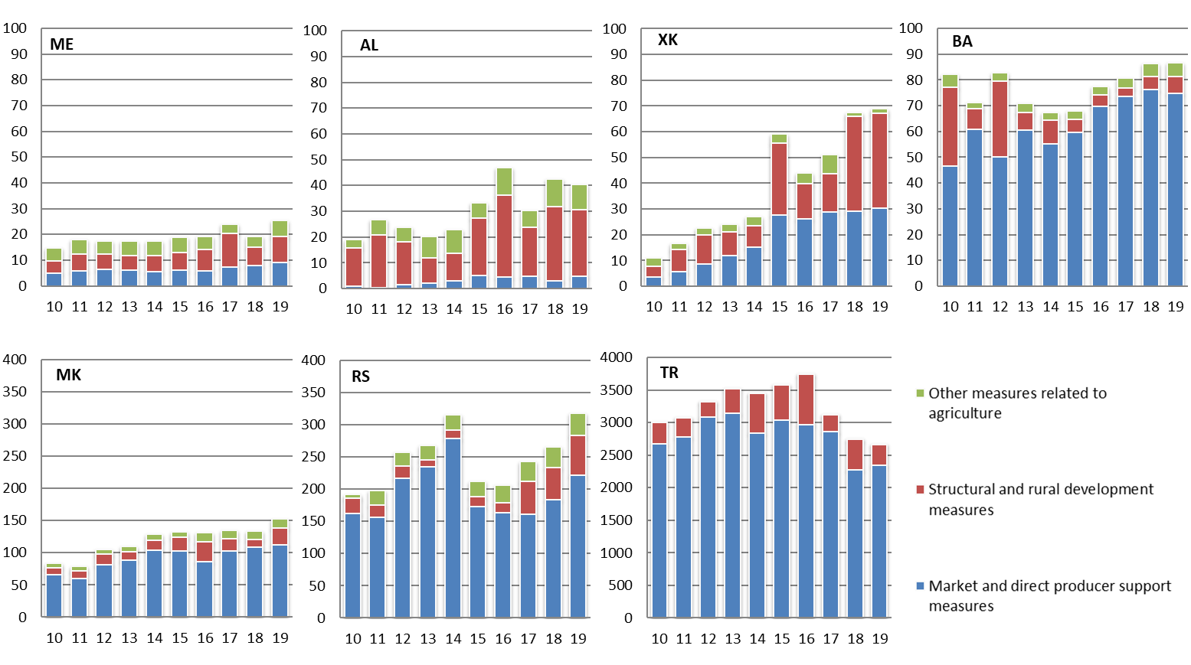
Size and allocation of policy support
Total budgetary support to agriculture (2010-2019), in mill. EUR
Other measures to agriculture
Structural and rural development measures
Market and direct producer support measures

Slide 10
Total budgetary support (2017-2019)
EUR/ha
EUR/inhabitant
Legend (APMC): Market and direct producer support measures;
Structural and rural development measures; Other measures to agriculture

Slide 11
Structure of budgetary transfers
Mill. EUR 38 85 63 23 140 276
Total Budgetary Support to Agriculture
(2017-2019), in % and mill. EUR
MDP/SRD ratio
(2017-2019)
Legend (APMC): Market and direct producer support measures;
Structural and rural development measures; Other measures to agriculture

Slide 12
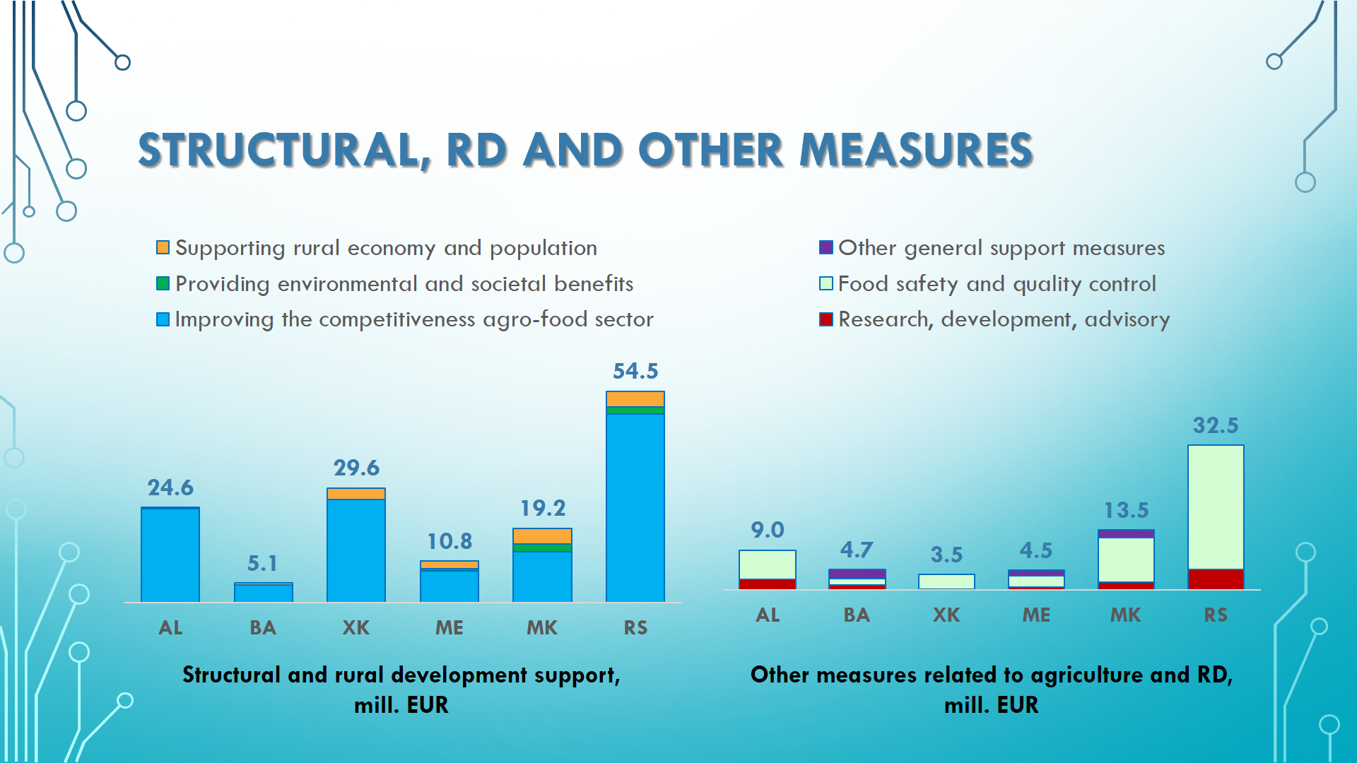
Structural, RD and other measures

Slide 13
Structural and Rural development measures
Budgetary support to agriculture by APMC groups (2017-2019), in mill. EUR
 | AL | BA | XK | ME | MK | RS
Improving the competitiveness of agro-food sector | 24.29 | 4.57 | 26.60 | 8.29 | 13.17 | 48.60
On-farm investment and restructuring support | 2.18 | 3.70 | 21.34 | 7.80 | 4.48 | 48.39
Agricultural infrastructure | 19.32 | 0.25 | 1.80 | 0.08 | 6.82 | 0.06
Off-farm storage, processing, marketing and promotion | 2.79 | 0.62 | 3.46 | 0.41 | 1.86 | 0.17
Providing environmental and societal benefits |  | 0.08 | 0.08 | 0.51 | 2.03 | 1.84
Payments to farmers in areas with natural & environmental constraints |  | 0.04 |  |  | 0.60
Agro-environment, organic and animal welfare payments to farmers |  | 0.06 | 0.08 | 0.51 | 1.43 | 1.84
Other ecosystem related payments
Supporting rural economy and population | 0.27 | 0.39 | 2.94 | 1.98 | 4.02 | 4.09
Creation and development of non-agricultural activities in rural areas | 0.27 |  | 1.21 |  | 0.03 | 0.05
Rural infrastructure, basic services and village development |  | 0.39 | 1.51 | 1.98 | 3.99 | 4.04
Building local capacity (LEADER) |  |  | 0.22
STRUCTURAL AND RURAL DEVELOPMENT MEASURES | 24.55 | 5.09 | 29.61 | 10.77 | 19.23 | 54.53

Slide 14
IPARD II (2014-2020) programme funding
Approved projects funds, in mill. EUR
 | AL | ME | MK | RS
EU part | 37.3 | 18.6 | 32.3 | 35.5
National contribution | 12.4 | 6.2 | 10.8 | 11.8
Total funds approved* | 49.7 | 24.8 | 43.1 | 47.4
EU indicated amounts | 71.0 | 39.0 | 60.0 | 175.0
Funds approved | 52.5% | 47.7% | 53.9% | 20.3%
*Note: Data available until 28.02.2020 (AL), 23.03.2021 (ME), 31.10.2020 (MK), 10.12.2020 (RS), 31.10.2020 (TR).

Slide 15
IPARD ii (2014-2020) Operational Measures
 | AL | ME | MK | RS
M1: "Investments in physical assets of agricultural holdings" | ✓ | ✓ | ✓ | ✓
M3: "Investments in physical assets concerning processing and marketing of agricultural and fishery products" | ✓ | ✓ | ✓ | ✓
M7: "Farm diversification and business development" | ✓ |  | ✓
“Missing” measures for promoting the transition to green economy – IPARD III…
Agri-environment, climate and organic farming
Forestry measures
Areas of Natural Constraints - ANC
Knowledge transfer and Advisory Services - role in promoting green economy
Implementation of local development strategies – LEADER approach
Investments in physical assets – focus on environment/climate/green economy

Slide 16
Concluding remarks and major challenges
The concept of green economy is still new to the WB countries...
Rich in natural resources, WBs face number of challenges in terms of economic development, job opportunities, infrastructure, social services etc. Farmers and rural population - a particularly vulnerable group in economic standing, providing for livelihood and ensuring sustainability.
Lack of competitiveness, limited access and sources of rural finance, poor rural infrastructure, trends of land abandonment and depopulation of rural areas, unfavourable structure in terms of education, qualifications and lack of knowledge and skills, as well as an overall unattractive social image of agriculture and living in rural areas, all represent serious constraints for the development of agriculture and the rural economy.

Slide 17
Concluding remarks and major challenges
The success of agriculture profoundly depends on its ability to coexist sustainably with the natural environment. Farmers are required to manage their production in a sustainable manner, protecting their surroundings, ensuring public health, plant health, animal health and welfare. This involves a mind-set change, level of social responsibility and ability to use pressures as opportunities.
To achieve the full economic potential of the sector, key challenge is the balance between promoting agricultural productivity and competitiveness alongside creating conditions for protection of environment and social sustainability in the rural areas.

Slide 18
Concluding remarks and major challenges
All countries have operational policy frameworks for designing and implementing agricultural policy - strategic planning promoting economic, environmental, and social objectives in the agricultural sector and rural regions.
Overall, agricultural policies of WBs are more focused on commitment and future planning (rather than actually implemented policy measures).
Implementation has mainly sectorial focus – stimulating production (mostly through coupled direct payments) or competitiveness (environmental orientation still marginal). Reverse in EU’s CAP!
Major challenge remains effective enforcement, where a key role plays the need for adequate institutional set-up and public administration capacities. IPARD – contributing to better preparation for this function.

Slide 19
Concluding remarks and major challenges
To be effective, the “green” policy toolkit should contain a combination of instruments: regulation (alignment with the acquis, increased green regulative and green procurement); support measures (decoupling farm support, increased support for environmental practices, extended cross-compliance requirements); economic instruments (simplified property and user rights, charges on excess use of environmentally-damaging inputs); R&D (increased funds for research on green agricultural technologies); knowledge, information and innovation transfer (AKIS, extension role); monitoring and evaluating the progress toward green economy (set of indicators).
In parallel, increased awareness and commitment and raising and building fluid knowledge across the sector, involving all key stakeholders (producers, processors, suppliers, advisory service, research community, CSOs, consumers) are essential for sustainability development and transition to green economy.

Slide 20

Thank you for your attention
Further reference:
https://seerural.org/
http://brd-network.org/category/knowledge-hub/
amartinovska@fznh.ukim.edu.mk

